Slide 1



SKP ENGINEERING COLLEGE
TIRUVANNAMALAI
A DEEP LEARNING ALGORITHM IMPLEMENTATION FOR CREDIT CARD FRAUD ANALYSIS AND DETECTION
FINAL REVIEW
BATCH 1
PRESENTED BY GUIDED BY
DHAVAMANI V (512220106001) Dr.BASKARAN S
KUMAR S (512220106002) SUPERVISIOR
PRAGADEESWARAN K(512220106001)

Slide 2
CONTENT
INTRODUCTION
ABSTRACT
OBJECTIVE
LITERATURE SURVEY
PROBLEM STATEMENT
EXISTING SYSTEM
BLOCK DIAGRAM OF EXISTING SYSTEM
DRAWBACKS OF EXISTING SYSTEM
BLOCK DIAGRAM OF PROPOSED SYSTEM
RESULTS
ADVANTAGES
CONCLUSION
REFERENCES
#

Slide 3

FRAUD TRANSACTIONS

Slide 4
INTRODUCTION
With the rapid development of the global economy in recent decades, credit cards have become much more popular for commercial transactions.
Finance and banking are very important sectors in our present-day generation, where almost every human has to deal with banks either physically or online.
Fraud refers to obtaining goods, services, and money by illegal means, which deals with events that involve criminal motives. That, mostly, is difficult to identify. Credit cards are one of the most popular targets for fraud.
Credit cards are becoming more and more popular in financial transactions, and at the same time, fraud is also increasing. Hence, the identification and detection of fraud are essential.

Slide 5
ABSTRACT
This project proposes A Deep Learning Algorithm Implementation for Credit Card Fraud Analysis and Detection. This work was developed by the Python Jupyter software.
Initially, the input dataset is initiated by a preprocessing technique. This process is handled by data cleaning, which helps clean the datasets and, additionally, handles the missing values.
Under pre-processing, the process started with data visualization process.
Which process is used to clearly show the patterns in the dataset and improve integrity.
Next, the data splitting process handles the data set and divides it for the purpose of the regression process. Deep learning algorithms are used in this work.

Slide 6
CONTINUED...
The deep learning technique that handles the MLP algorithm is to predict fraudulent transactions and normal transactions.
The final step is predicting whether the output of identification for fraudulent transactions is achieved in the model evaluation process.

Slide 7
OBJECTIVE
To predict whether a credit card transaction is fraudulent or not.
To efficiently classify credit card frauds accurately using a multilayer perceptron (MLP) classifier.
To evaluate the precision and recall value by using a deep learning classification model.

Slide 8
LITERATURE SURVEY
SL. NO | TITLE /AUTHOR | METHODOLOGY | ADVANTAGES | DISADVANTAGES
1. | ‘An efficient credit card fraud detection model based on machine learning methods’ & N. K. Trivedi et al [2020]. | An effective credit card fraud detection mechanism including a feedback system, dependent on machine learning methodology is presented in this paper. | Cost-effectiveness. Utilizing this technique, clients feel confident. | Different machine learning methods are essential to be implementing and testing.
2. | ‘Credit Card Fraud Detection Using Machine Learning As Data Mining Technique’ & O. S. Yee et al [2018]. | The supervised-based classification using Bayesian network classifiers, namely K2, Naïve Bayes, and logistics classifiers, is presented in this paper. | Better results are achieved. | Future study is needed to explore more credit Card fraud detections using real time data.

Slide 9
LITERATURE SURVEY
SL. NO | TITLE /AUTHOR | METHODOLOGY | ADVANTAGES | DISADVANTAGES
3. | ‘Deep learning detecting fraud in credit card transactions’ & A. Roy et al [2018]. | This paper presents, a subsection of Deep Learning topologies from the general artificial neural network to topologies with built-in time and memory components. | High performance. | Initial grid search needs to be improved.
4. | ‘Real-time Credit Card Fraud Detection Using Machine Learning’ & A. Thennakoon et al [2019]. | A credit-card fraud detection system for detecting four different patterns of fraudulent transactions using the best-suited algorithms is proposed in this work. | It alerts the bank about the fraud pattern and accuracy rate. | Location-based frauds need to be focussed. Better prediction is needed.

Slide 10
LITERATURE SURVEY
SL. NO | TITLE /AUTHOR | METHODOLOGY | ADVANTAGES | DISADVANTAGES
5. | ‘Credit card fraud detection using Machine learning algorithms’ & A. Bhanusri et al [2020]. | The concept of frauds related to credit cards is presented in this paper. | It Provides better solution. It reduce the risks. | Fraud and un-fraud transactions is not detected.
6. | ‘Predictive Modelling For Credit Card Fraud Detection Using Data Analytics’ & Suraj Patil et al [2018] | A robust framework to process large volume of data proposed in this paper. | Analytical accuracy of fraud prediction is improved. Low risk. High customer satisfaction. | The over fitting problem of decision tree need to be removed.

Slide 11
Problem statement
Location-based frauds need to be focused.
Better prediction is needed.
Different machine learning methods are essential to be implementing and testing.
Initial grid search needs to be improved.

Slide 12
EXISTING SYSTEM
In this existing system, fraud detection in banking data by machine learning techniques is developed.
First, apply the desired pre-processing the data and further dividing the data into two sections: training and testing.
Followed by performing Bayesian optimization on the training data to find the best Hyperparameter that lead to the improvement of performance.
Weight-tuning as a pre-process for unbalanced data, as well as CatBoost and XGBoost to improve the performance of the LightGBM method by accounting for the voting mechanisms, are used.
The cross-validation method is used to obtain a performance comparison in an unbalanced set and then examine the algorithms using different evaluation metrics.

Slide 13
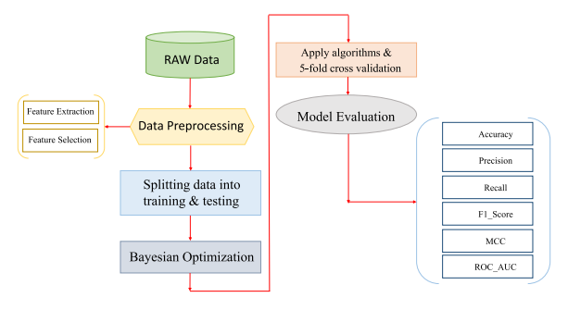
BLOCK DIAGRAM OF EXISTING SYSTEM

Slide 14
DRAWBACKS of existing system
However, this method causes an increase in the false-positive rate, which is not acceptable in banking for customer orientation.
Additionally, the results cannot be cited because false negatives are far from the view of this ROC-AUC curve diagram.

Slide 15
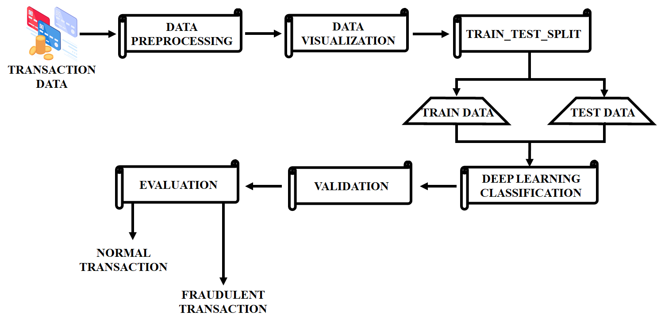
BLOCK DIAGRAM OF PROPOSED SYSTEM

Slide 16
PROPOSED SYSTEM
In this project, A Deep Learning Algorithm Implementation for Credit Card Fraud Analysis and Detection is proposed.
First, the input dataset is allowed to undergo preprocessing. which involves cleaning and analyzing the input dataset and handling the missing values.
Following data pre-processing, the next stage of data visualization Matplotlib and Seaborn tools are used in the data visualization process. These modules are used for observing, exploring, and understanding the data in detail.
Next, the data splitting process handles the data set and divides training and testing data for the purpose of the regression and identification process.
Then the datasets are allowed to be classified using the classification techniques of deep learning.

Slide 17
CONTINUED...
The deep learning technique handles the MLP algorithm. It works to handle robustness, missing data, and feature importance analysis against overfitting.
Which makes it a popular option for a variety of uses, including prediction and detection issues. Additionally, the classification techniques provide excellent specificity and sensitivity.
Following that, data validation is employed to improve integrity. Finally, the predicted fraudulent transaction is identified in the evaluation block.
Overall, the proposed project was developed in Python, employing the Jupyter software.

Slide 18
SOFTWARE REQUIREMENTS
LANGUAGE : Python
SOFTWARE : Jupyter software

Slide 19
MODULES DESCRIPTION
Data Preprocessing:
Data preparation is the process of preparing raw data so that it is suitable for further processing and analysis.
Data preparation is necessary in machine learning as raw data, in most cases, has various issues like missing values, irrelevant feature variables, inconsistent column values, etc.
Data cleaning:
The data is not in a specific range, so the preprocessing technique is used to fit the dataset into an exact range. Several approaches are available for the normalization of the dataset.
In this work, the data cleaning technique is used for cleaning the data, removing null values, and handling the missed values of the datasets.

Slide 20
MODULES DESCRIPTION
Data Visualization:
Data visualization is the practice of translating information into a visual context, such as a map or graph, to make data easier for the human brain to understand and pull insights from. These processes are handled in two modules: Matplotlib and Seaborn.
Matplotlib:
Matplotlib is a comprehensive library for creating static, animated, and interactive visualizations in Python. Matplotlib makes easy things easy and hard things possible.
Seaborn:
Seaborn is a library for making statistical graphics in Python. It builds on top of Matplotlib and which work on exploring and understanding the data.

Slide 21
MODULES DESCRIPTION
Deep Learning Classification:
MLP:
A multilayer perceptron (MLP) is made up of multiple layers, each of which is connected to the next. Each node is a processing element or a neuron that has a nonlinear activation function except the input nodes.
It employs back propagation, a supervised learning technique, to train the network. It is a feed forward artificial neural network model that maps input sets to output proper sets.
The final stage is the prediction process, output is generated by the output layer using the data processed in the hidden layer.

Slide 22
MODULES DESCRIPTION
Validation:
A validation data set is used in deep learning to compare the performance of different trained models.
Data validation means checking the accuracy and quality of source data before using, importing or otherwise processing data.
Model Evaluation
The method of evaluation focuses on the accuracy of the model in predicting the end outcomes.
Even though there are several stages, the stage of evaluating a DL model is the most crucial because it gives us an idea of the accuracy of model prediction.

Slide 23
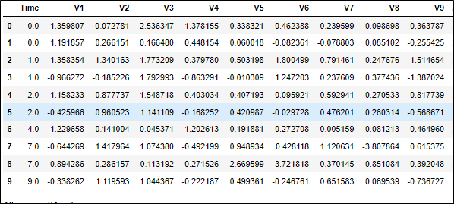
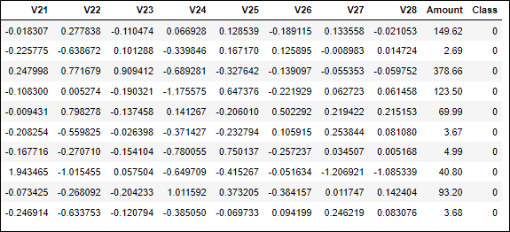
RESULTS
DATASET

Slide 24
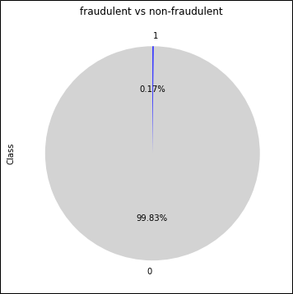
RESULTS
DATA DISTRIBUTION

Slide 25
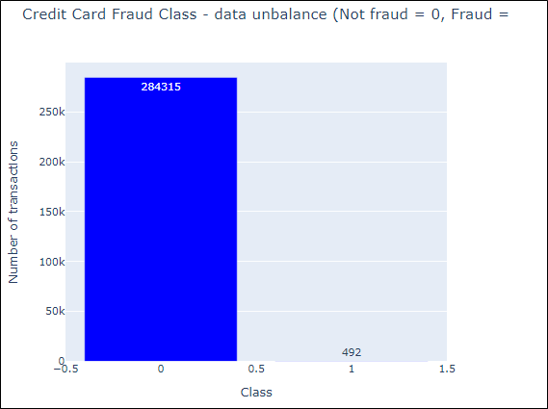
RESULTS
CLASS DISTRIBUTION

Slide 26
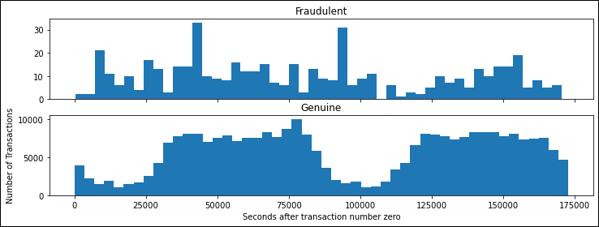
RESULTS
EXPLORATION OF TRANSACTIONS

Slide 27
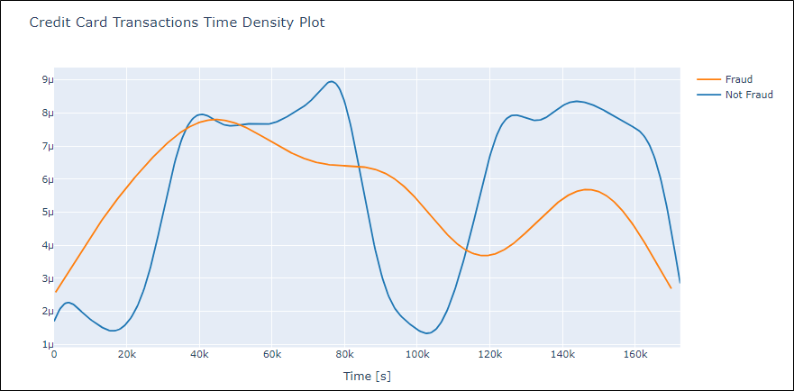
RESULTS
TRANSACTIONS TIME DENSITY PLOT

Slide 28
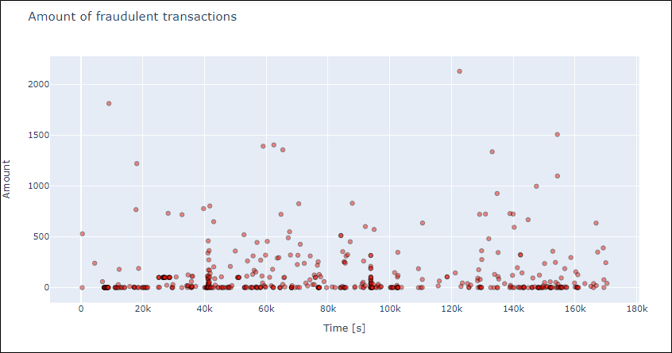
RESULTS
FRAUDULENT TRANSACTION

Slide 29
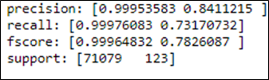
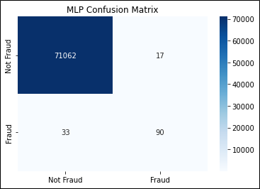
RESULTS
CONFUSION MATRIX OF MLP

Slide 30
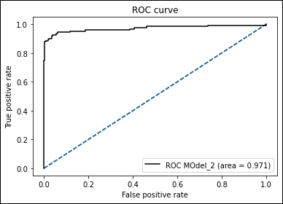
RESULTS
ROC CURVE OF MLP

Slide 31
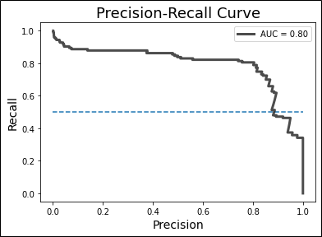
RESULTS
PRECISION RECALL CURVE OF MLP

Slide 32
ADVANTAGES
High customer satisfaction.
It alerts the bank about the fraud pattern and accuracy rate.
Cost-effectiveness.
Better classifier output.

Slide 33
APPLICATIONS
Object detection image.
Immune response abnormalities.
DDOS Attack Detection.
Wireless Communication.
Network Security.

Slide 34
CONCLUSION
In this project proposes, a Deep Learning Algorithm Implementation for Credit Card Fraud Analysis and Detection was implemented. The detection of credit card fraud is a vital research field.
This is because of the increasing number of fraud cases in financial institutions.
This project opens the door for employing machine learning to build systems that can detect fraud. Building an automated-based system to detect fraud requires a database to train the system (or classifier).
This work demonstrates the advantages of applying deep learning techniques, including MLP classification techniques, to the credit card fraud detection problem for the purpose of reducing the bank's financial risks.
Finally, the proposed classifier is evaluated based on its accuracy, and the MLP classifier generates the best results. Using these methods for the detection of credit cards yields better performance than traditional algorithms.

Slide 35
REFERENCES
Trivedi, N.K., Simaiya, S., Lilhore, U.K. and Sharma, S.K., An efficient credit card fraud detection model based on machine learning methods. International Journal of Advanced Science and Technology, 29(5), pp.3414-3424, 2020.
Yee, O.S., Sagadevan, S. and Malim, N.H.A.H., Credit card fraud detection using machine learning as data mining technique. Journal of Telecommunication, Electronic and Computer Engineering (JTEC), 10(1-4), pp.23-27, 2018.
A. Roy, J. Sun, R. Mahoney, L. Alonzi, S. Adams and P. Beling, "Deep learning detecting fraud in credit card transactions," 2018 Systems and Information Engineering Design Symposium (SIEDS), pp. 129-134, 2018.
Thennakoon, C. Bhagyani, S. Premadasa, S. Mihiranga and N. Kuruwitaarachchi, "Real-time Credit Card Fraud Detection Using Machine Learning," 2019 9th International Conference on Cloud Computing, Data Science & Engineering (Confluence),pp. 488-493, 2019.
Bhanusri, A., Valli, K.R.S., Jyothi, P., Sai, G.V. and Rohith, R., 2020. Credit card fraud detection using Machine learning algorithms. Journal of Research in Humanities and Social Science, 8(2), pp.04-11.
Patil, S., Nemade, V. and Soni, P.K., Predictive modelling for credit card fraud detection using data analytics. Procedia computer science, 132, pp.385-395, 2018.

Slide 36


